Slide 1

Boneyard Flat Phase 2
Special Use Permit
Board of Adjustment – April 16, 2020

Slide 2
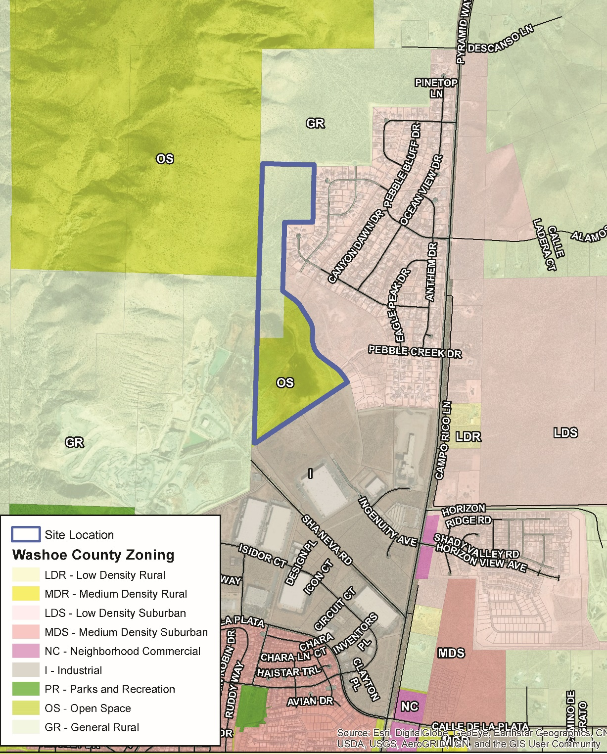
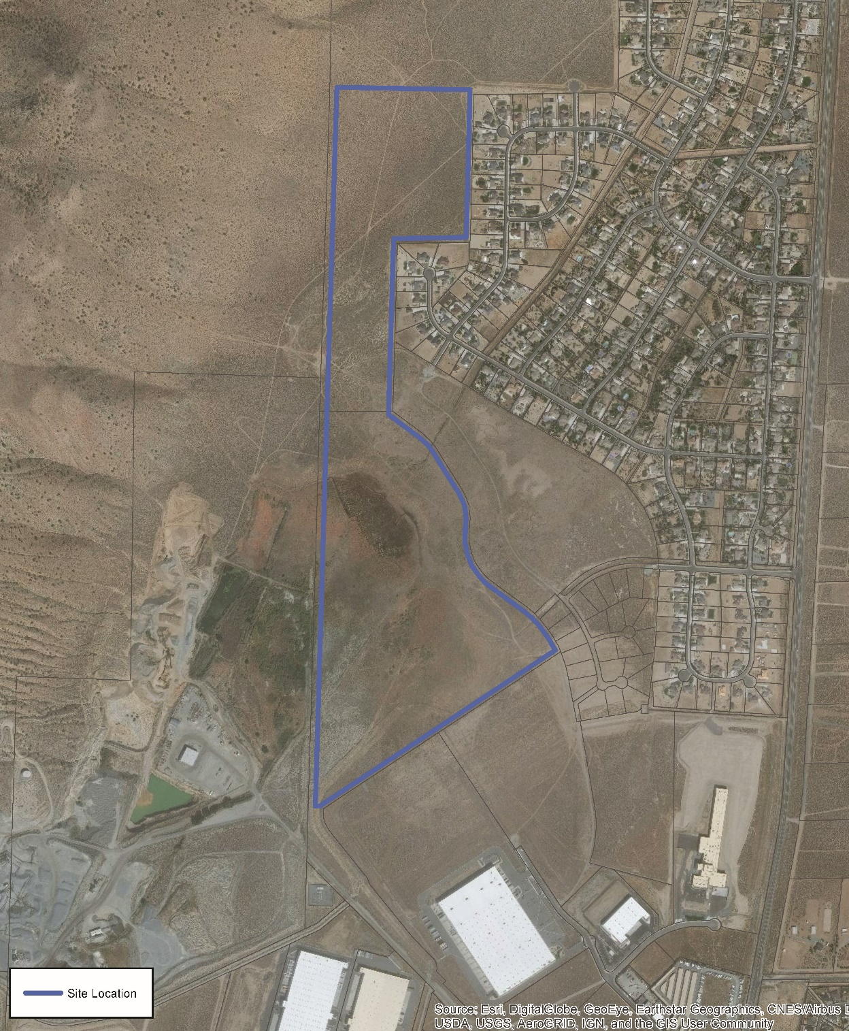

Project Area
APNs 538-020-01 & 538-010-12
±188 Acres

Slide 3
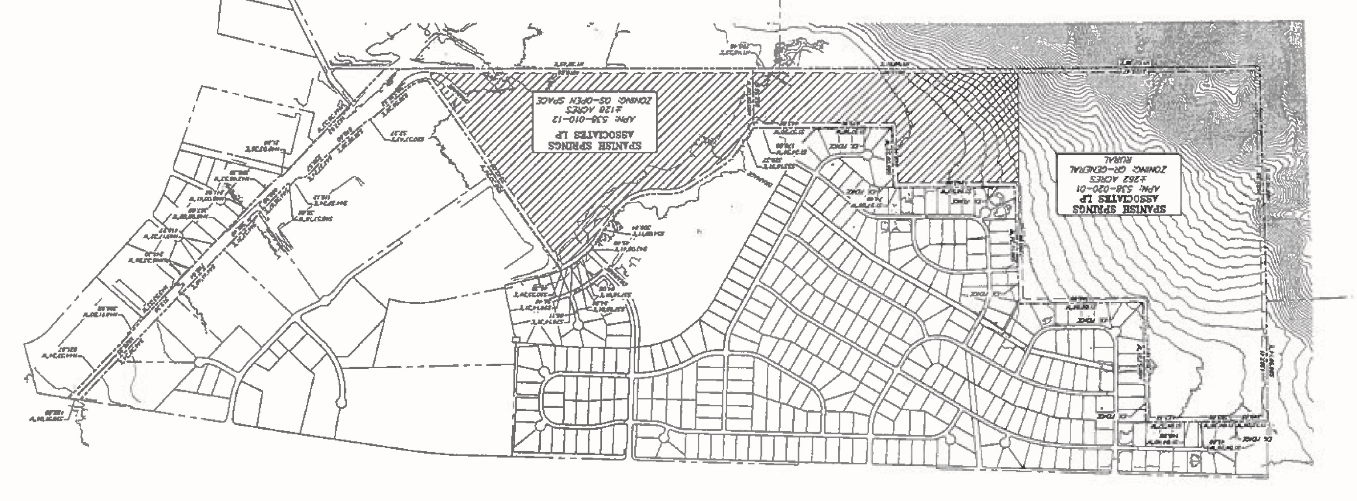

Boneyard Phase 1:
WSUP19-0016 Approved October 3, 2019
±188 Ac Project Area
500,000 CY of fill material
Boneyard Flat is currently identified as a flood pool area by Washoe County
Background

Slide 4
Proposed Boneyard Ph 2:
Same Project Area as Phase 1 (±188 Ac)
Additional 1 million CY of fill material (1.5 million CY total Ph1 & Ph2)
North Spanish Springs 100-year Flood Elevation lowered 1-foot for every 600,000 CY excavated
SUP Request

